Slide 1
Introduction to Big Data
Day 1
Introduction to Big Data, Analytics
and Business Problem Framing

Slide 2
Day 1 – Major Topics Introduced
The following major topics are introduced and described today.
Big Data
Data Analytics
Business Questions
Big Data and Analytics
Analytical Models
Statistical Methods
Python Jupyter Notebooks
Understanding these concepts will provide you with a solid foundation to master the material and develop the necessary skills through the rest of the course.

Slide 3
Lesson 1 - Learning Objectives
Goal of this content:
Describe the curriculum and the course learning objectives and grading scheme
Define big data in terms of structure, sources, impact, business opportunities and key characteristics
Define data analytics based on its recent history, terminology, purpose, structure and capabilities
Describe key areas data analytics functionality that helps answer different types of business questions
Describe how combining Big Data with Analytics can drive improved business performance through proper business problem framing
Describe the structure, purpose and limitations of analytical models
Describe the roles that statistical methods play in creating useful information from raw data

Slide 4
What is Data?
data (n.) -1640s, classical plural of datum, from Latin datum "(thing) given," neuter past participle of dare "to give" (from PIE root *do- "to give"). Meaning "transmittable and storable computer information" first recorded 1946. Data processing is from 1954.
The Latin word data is the plural of datum, "(thing) given” or "to give“
Data = Signals, Symbols…Inherently Meaningless

Slide 5
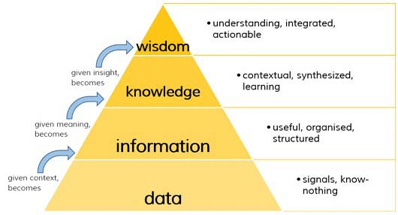
DIKW Pyramid
Data, information, knowledge and wisdom are closely related concepts, but each has its own role in relation to the other, and each term has its own meaning.
According to a common view, data is collected and analyzed;
Data only becomes information suitable for making decisions once it has been analyzed in some fashion.

Slide 6
Big Data

Slide 7
Big Data Definitions
A variety of definitions and perspectives
Commonly described according to the 3 V`s
Volume
Velocity
Variety
Additional description related to
Veracity
Value

Slide 8
Small vs. Big
The ultimate goal for data analysis to get timely insights to support decision making.
Categorizing data into Small and Big help to tackle challenges in analyzing data of each world separately with proper tools.
The line between two categories varies with emerging advanced data processing systems which makes even big data querying much faster and less complex.
Big Data vs Small Data science:
populations, not samples;
messy, not clean data, and;
correlations, not causality

Slide 9
Big Data Concepts
Consider what makes data ``big``
Big data isn`t really about size or volume (although it is a factor)
Big data
is challenging to manage
can be impactful
can be transformational
is changing how we live our lives
is changing how companies compete
should be important to our strategy
can be complex
by itself does not create value
can create value if analyzed and acted on

Slide 10
Big Data Concepts
Big data
is generated by living our personal and corporate lives
can be described as ``non-traditional``
requires innovations in technology to manage and apply it
is largely created by someone other than us
can be misleading

Slide 11
Big Data Structure
Structure of data dictates its `Variety``
Structured
Data is organized in a tabular format at the ``field`` level
Eg. Spreadsheets and data base tables
Unstructured
The structure is unknown
Eg. Images, audio, video,
Multi-structured
The structure includes a combination of tabular, hierarchical, tagged, other and unknown
Eg. Emails and Twitter feeds contain some known fields such as the ``From`` and ``To`` parties combined with unstructured text

Slide 12
Big Data Sources
Types of Sources
Internal
Generated by internally managed business activities
Generated by staff, contractors and partners known to us
Examples
Systems for ERP, Operations, CRM, transaction records, production
Sensors, text documents, audio, video, images, maps, web logs, etc
External
Generated by external activities
Generated by organizations, people or equipment who are likely unknown
Examples
Social media, open data, public data, blogs, news feeds, audio, video, images, sensors, IOT devices, smart phone communications, wearable devices, web sites, data markets, location data using GPS, data subscription services

Slide 13
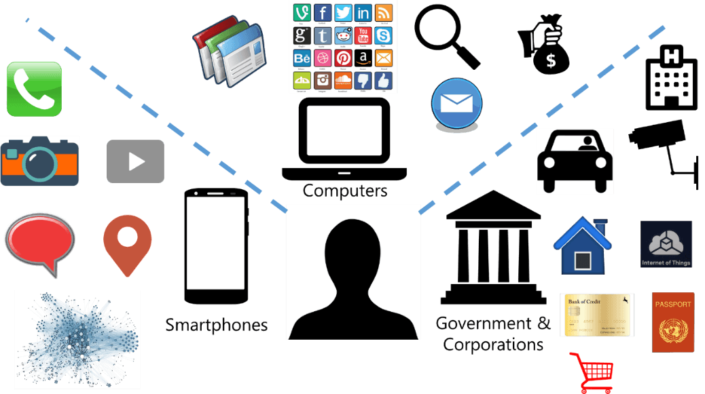
Big Data Sources:

Slide 14
Big Data
Example data
Full motion video
Multi/hyper-spectral imagery
Cell phone calls
Register transactions
Lidar/point clouds
Email/tweets
Space/time critical

Slide 15
Big Data
Query Optimization
Traditional data types solved long ago
Big problems with extended data types
Revert to full table scans
One solution: massively parallel systems, data partitioning, etc.
IBM’s Netezza, Oracle’s Exadata, Microsoft’s SQL Azure, Apache’s Hadoop, Teradata, among others
Can a finely tuned query win?

Slide 16
Big Data Impact
Areas where Big Data makes an impact
Enhanced Surveillance and Monitoring
Customer Intimacy and Relationships
Government and Corporate Transparency
Fraud detection
Improved risk management
Enriched information for predictive models
Personal fitness management
Consumer purchase choices
Micro-market segmentation
Smart grid management for energy conservation
Improved physical asset reliability
Location and route optimization
Crowdsourcing of opinions

Slide 17
Big Data
How to stream for real time event processing
Store to disk/post process
Analyst with manual inspection
Slow
How to persist/partition and rapidly search

Slide 18
Big Data
Search criterion controlling storage
Based upon predicate filtering
Temporal, then spatial, or vice versa
Placenames
Type of attribute/tags
Sensor platform attributes
Column-oriented stores

Slide 19
Big Data
Peeking at data as it flows in
Identify interesting bits, ignore most
When is something near, when does something cross …
Query optimization problem
Existing frameworks
Microsoft, Oracle, IBM, etc.

Slide 20








Move is to dynamic data, applying analytics to large volumes, reporting facts as available
Data Streams
Discovery
Filter/Store/Analyze
Disseminate
Analytics, filters, correlation results
Alerts, facts, etc. feed into other Analysts
Analyst
CLOUD BASE
Analytics run in
GRID Computing,
Hadoop, and
Map Reduce
environment
Question focused datasets
Creates the analytics to apply to the data stream based on
Pattern Analysis
Reports, analysis, other web pages

Slide 21
Big Data
Detecting patterns, connecting thing together
Social media type stuff with spatial/temporal
Cash register transactions, cell phone calls
Pattern of life
“Connecting the dots”
Knowns and unknowns
How to assign unknowns to knows
How to assign confidences

Slide 22
Temporal Anomalies
A half-million Enron e-mails from ~150 accounts were sent from 1999 to 2001, a period when Enron executives were manipulating financial data, making false public statements, engaging in insider trading, and the company was coming under scrutiny by regulators
The graph reveals a map of a week's e-mail patterns in May 2001, when a new name suddenly appeared
This week's pattern differed greatly from others, suggesting different conversations were taking place that might interest investigators

Slide 23
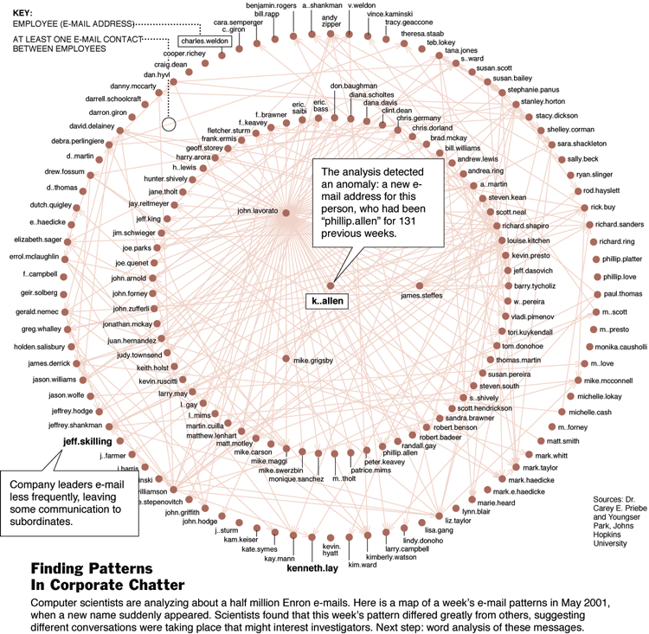
Temporal Anomalies

Slide 24
Big Data
Spatio-temporal web crawlers
Trends and spatial activity
Social media
Meaningful persistence
Fast, geolocate, query

Slide 25
Non-traditional Data
Lots of non-spatial data
CSV/TXT files, Excel spreadsheets, news feeds, social media
Coarse grained spatial data
City level, not down to 10 meters …
E.g., Fukushima radiation
Geoprocessing and trend analysis/detection

Slide 26
Big Data Opportunities
It is important to understand all of the components needed to transform data into business value
A Big Data Opportunity must specify how these levels will contribute to value
These levels represent a value chain from Data (level 1) to Value (Level 6)
All of these components must function to deliver value at the top of the chain
Level 6- Value
Measurable improvement in a business result. This is ``value
Level 5 - Action
Execution of `the right work or activity to drive the impact
Level 4 - Decision
Selective choice made to take an action that drives impact
Level 3 - Analytics
Determining the business questions to ask
Generating new information and insights
Level 2- Information
Answers to questions that will guide decisions
Level 1 - Data
Building blocks used to create meaningful answers to drive actions

Slide 27
Big Data Value Chain
Value
Delivered
Value
This model shows the activities
needed to transform data into value
Note how technology components enable
human components to create value
Actions
Decisions
Human
Activity
Increasing Value
Examples of Value
Lower cost
Higher revenue
Lower risk
Cleaner environment
Safer workplace
Satisfied customers
Analytics
Information
Technology
Data

Slide 28
Big Data Opportunities
Discovering Opportunities
Determine what business impact is desired and how creates value
Understand what actions and decisions will lead to the desired impact
Determine what questions need to be answered to guide the decisions
Ensure experienced people can frame the questions that can be answered
Provide information to answer the questions
Information is created by integrating available data and using analytics to generate net new insights
Data is gathered and must be in an ``analyzable`` condition
Data conditions include security, quality, accessibility, integration and timeliness

Slide 29
Big Data Key Characteristics
Big Data is characterized by
Volume
Describes the quantity of data in terms of breadth, granularity and history
As data volumes grow, traditional technology has difficulty scaling
Variety
Describes multiple formats, structures and time intervals
As variety increases, traditional technology has difficulty keeping pace it
Velocity
Describes the trend towards data flowing faster and faster nearing real-time
As velocity increases, traditional technology has difficulty keeping pace
Veracity
Describes the level of confidence and trust we place in the data
As more data is acquired that was generated externally, this issue increases
Value
Describes the positive impact made by utilizing data
Companies have difficulty with this

Slide 30
Data Analytics

Slide 31
Data Analytics Terminology
Business Intelligence
An organization`s capability to intelligently set and accomplish goals
Analytics
The ability to generate meaningful insights to support
Data Warehousing
The ability to organize data into a form that can be analyzed
Data-Driven
Utilize data as evidence to guide decision making and results monitoring
Big Data Analytics
The application of analytics methods to the wide range of available big data sources (internal and external) to generate new and powerful insights.

Slide 32
Data Analytics Recent History
The 1990`s
Early applications of data warehousing to unify tabular, internal data to enable integrated business reporting
Analytics was in the form of using integrated facts to drive improved decision making
The 2000`s
Maturing of the internet as a platform for entertainment, commerce and communications
Emergence of the smart phone, GPS systems and social media
Data started taking on the characteristics of ``big``
Analytics was in the form of advanced monitoring and control
The 2010`s
Emergence of the digital economy and society
Mass installation of surveillance and sensor systems
Maturing of social media and digital communities
Analytics broadened into a range of new capabilities including predictions

Slide 33
Data Analytics Value Concepts
Analytics uses available data to generate different categories of insights.
Analytics is not a single step in a value chain
Analytics is a series of activities that build on each other as new insights are generated and applied to subsequent steps
New value is added to an original data set as broader sets of insights are generated from it.
If data is a basic asset in an organization, then analytics is the engine that drives value from it.

Slide 34
Data Analytics Value Examples
Value delivered by Analytics is described in a Value Chain model discussed earlier
The 5 major categories of value that can be enabled by data analytics are
Effectiveness
ensures that the “right” work is done to accomplish goals
Efficiency
ensures that work is done “well” and fewer resources are consumed to produce a given level of outputs
Agility
enables organizations to respond to changing market conditions
Quality
enables consistent results with fewer defects and less re-work
Innovation
enables new disruptive models to be tested and implemented

Slide 35
Data Analytics Purpose
Data Analytics Generates New Information and Insight
New information provides:
answers questions that could not otherwise be answered
facts about time periods such as the past, present of future
descriptions of scenarios that never actually took place
Insight provides knowledge:
that can generally be applied to our domain
that helps us understand how our world actually works
that can be applied in a competitive sense
that can help us improve organizational performance

Slide 36
Data Analytics Structure
Data Analytics includes
Framed business problems including assumptions
Defined analytic problems to address the business problem
Training and testing data sets
Algorithms to create models from the training data
Evaluation of models based on test data sets
Implemented and deployed models
Decision variables, outcome variables, parameters and constraints
Visualizations used to interpret model results
Human expertise with mental processes to interpret and apply the results
Human expertise with communication skills to tell stories and share the results

Slide 37
Data Analytics Capabilities
Major Categories of Capabilities are Based on Functionality
Discovery Analytics
Statistical and visualization methods for finding useful patterns and relationships
Descriptive Analytics
Measurement methods used to quantify and describe a domain using statistical techniques
Diagnostic Analytics
Abnormal condition detection and root cause analysis
Predictive Analytics
Models used to estimate future conditions and the probability of events
Prescriptive Analytics
Models that guide decision makers towards a feasible scenario using simulation or an optimum scenario using optimization

Slide 38
Framing Questions

Slide 39
Business Question Concepts
Business questions
provide a foundation to define the requirements of an analytics solution
contain two components, a fact and multiple qualifiers
analytic questions usually have a quantitative fact
operational questions may have qualitative or quantitative facts
qualifiers are qualitative and become dimensions
Example
Question
How many customers will respond to our marketing programs over the next 3 years by month, by product and by campaign
Fact
count of customers
Qualifiers
month, product and campaign

Slide 40
Business Question Types
Operational Questions
Focus on a specific event, condition or transaction
Examples:
Which customer requires a follow up
When the package arrive
What is the delivery status of the last shipment
Analytical Questions
Focus on counts, totals and aggregates grouped by criteria
Examples:
How is our customer base broken down by satisfaction category
How many products are in the low quality category by shift
How many accidents do we expect at rush hour in the financial district during the upcoming holiday season

Slide 41
Business Questions and Analytics
Categories of Business Questions with Examples
Who
Segment employees or customers based on descriptive analytics
What
Identify an abnormal condition based on diagnostic analytics
Where
Group intersections by accident likelihood based on predictive analytics
When
Forecast future demand by month based on predictive analytics
Why
Determine root cause of quality defects based on diagnostic analytics
How
Prescribe how to respond to a delay based on prescriptive analytics

Slide 42
Big Data and Analytics

Slide 43
Business Performance Concepts
Performance describes how closely a controlled variable tracks to a target variable established by a goal.
High performance exists when the controlled variable is within an acceptable tolerance of a target
Low performance exists when the margin between the controlled variable and a target is significantly large
The management of performance (performance management, business performance management and corporate performance management) adjusts the decision (input) variables to maintain an acceptable level of performance
Managers must determine what decisions and actions will result in desired levels of performance
Decision variables are manipulated to drive output variables to an acceptable level based on a target

Slide 44
Business Performance Measurements
Measurements quantify the position, level or condition of input and output variables.
Definitions
Measures
Quantitative data elements recorded at a point in time
Describe properties or attributes of things we need to manage
Metrics
Information derived from measures to inform decision making
Business metrics are outcome variables with targets
Metrics are input variables that do not have targets
Indicators provide evidence of a condition similar to metrics
Performance Indicators provide evidence of performance levels
Key Performance Indicators (KPI`s) are a few strategic indicators

Slide 45
Business Problem Framing
Business problems initially are commonly vague and ambiguous
Problem Framing provides structure to define:
The heart of the problem
A short description of the problem in business terms
Why the problem should be solved
Outcome variable(s) including target levels and deadlines
Input decision variable(s) that can be manipulated
Input parameters based on assumptions
Historical or timing implications of the problem

Slide 46
Analytical Models

Slide 47
Analytical Models Definitions
Models are representations of reality
Data are abstractions of signals, signs, and symbols. “Bits of reality”
They are based on assumptions and simplifications
George Box (a famous statistician) quote:
``All models are wrong. Some are more useful than others``
Models transform input variables into output variables

Slide 48
Analytical Models Structure
Models represent a simplified view of reality
Input variables are processed by an algorithm or a set of rules to produce output variables
A simple model may be built using an algorithm that models the problem
A complex model may require many sub-models to work together, each one addressing a piece of the larger problem

Slide 49
Analytical Models Categories
Empirical
model is created based strictly on observed data
Mechanistic
model is created based on theoretical rules and formula
Deterministic
model does not consider randomness or uncertainty
Stochastic
model considers randomness and provides a range of output values
Continuous
model works with fractions and real numbers
Discrete
model works with integers and whole numbers

Slide 50
Analytical Models Purpose
Models generate new information and insights that enable the class of business questions that were created by framing a business problem
The focus of information and insights is to ensure that they are useful and relevant relate by answering key business questions that are framed as part of the analytics effort

Slide 51
Analytical Models Limitations
Models must be calibrated over time to ensure that the error produced by the model is recognized and understood
Models based on empirical data are limited to the range of data within the training data set.
Models may not generalize beyond the range of observed data.

Slide 52
Statistical Methods

Slide 53
Statistical Methods Overview
Techniques for understanding and summarizing data values for a single variable
Descriptive statistics
Provides methods for describing data values to understand similarities and differences about attributes within the sample
Provides measures of central tendency and dispersion
How data clusters around a defined point and how it spreads away from that point provides us with the shape of the data for a given variable.
Inferential statistics
Provides methods to generalize our belief about the greater population represented by the sample that was gathered
Allows us to use a generalized model in a wide range of analytics applications
Helps us design experiments to gather samples and generalize the results to the broader population
Techniques for describing the relationships between two variables
Correlation

Slide 54
Statistical Methods to Understand Data Shape
Variables from a data sample possess a set of properties that define its shape
Values cluster around the central tendency
Central tendency is measured by the following descriptive statistics
Mean is the arithmetic average
Median is the middle value
Mode is the most common value
The amount of spread is called dispersion or variation
Dispersion is measured by the following descriptive statistics
Variance
Standard Deviation is the square root of variance
Methods of calculation and application will be discussed later in the course
The measures of central tendency and spread provide a signature about the broader population described by the variable.

Slide 55
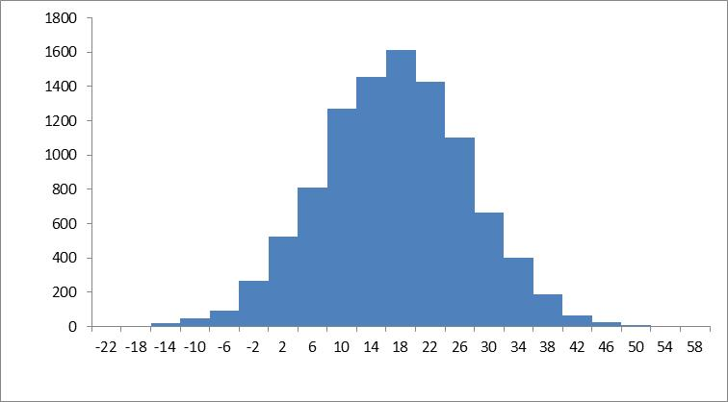
Statistical Methods to Understand Data Shape
Standard
Deviation = 10.0
Mean = 15.1
Frequency Histogram for Variable X

Slide 56
Lesson Review

Slide 57
Lesson Review
Consider the following questions based material describe in this lesson and be prepared to discuss with the instructor in class next Day.
Describe the key components to transform data into business value
Describe how Big Data is different from traditional Small Data
Identify some of the historical events since the year 2000 that have catalysts for the Big Data era
Differentiate data from information
Explain the major purposes of analytics
Describe how business problems need to be translated and framed to take advantage of analytics including the essential components of a framed problem
Describe how data analytics relates to business performance management
Describe the main role of statistics in describing data
Describe the main set of analytics capabilities that are in common use

Slide 58
Lesson Summary

Slide 59
Lesson 1 Summary
During this lesson, you learned to:
Describe the curriculum and the course learning objectives and grading scheme
Define big data in terms of structure, sources, impact, business opportunities and key characteristics
Define data analytics based on its recent history, terminology, purpose, structure and capabilities
Describe key areas data analytics functionality that helps answer different types of business questions
Describe how combining Big Data with Analytics can drive improved business performance through proper business problem framing
Describe the structure, purpose and limitations of analytical models
Describe the roles that statistical methods play in creating useful information from raw data

